Slide 1
Data structures-3

Slide 2
Dictionary
Dictionary is a collection which is unordered, changeable (mutable) and indexed.
It does not allow duplicate members.
Unlike other data structure ( list, tuple and set), a dictionary has a key : value pair.
Dictionaries are optimized to retrieve values when the key is known.

Slide 3
Creating dictionary:
Creating a dictionary is as simple as placing items curly braces {} separated by comma.
An item has a key and the corresponding value expressed as pair, key : value.
While values can be of any data type and can repeat, keys must be of immutable type ( string, number or tuple with immutable elements) and must be unique.

Slide 4
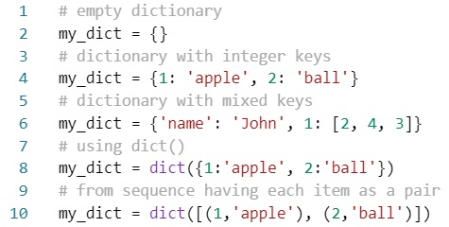
Code:
As we see above, we can also create a dictionary using dict() method.

Slide 5
Accessing elements from dictionary:
Indexing is used in other data structures to access values, dictionary uses keys.
Keys can be used either inside square brackets or with the get() method.
The difference while using get() is that it returns None instead of KeyError, if the key is not found.

Slide 6
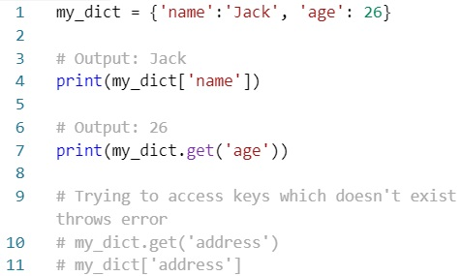

Code:
output

Slide 7
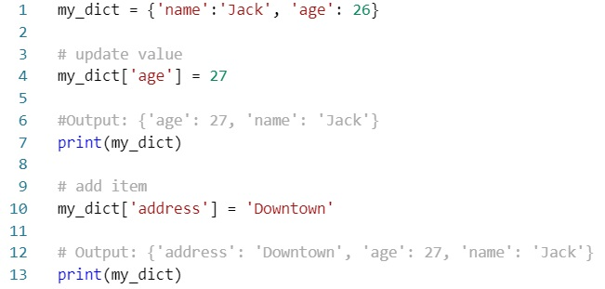

Change or add elements:
Dictionary are mutable. We can add new items or change the value of existing items using assignment operator.
If the key is already present, values gets updated, else a new key : value pair is added to the dictionary.

Slide 8
Deleting or removing elements:
Can remove a particular item in a dictionary by using the method pop(). This method removes as item with the provided key and returns the value.
The method popitem() can be used to remove and return an arbitrary item ( key, value) from the dictionary.
All the items can be removed at once using the clear() method.
We can also use the del keyword to remove individual items or the entire dictionary itself.

Slide 9
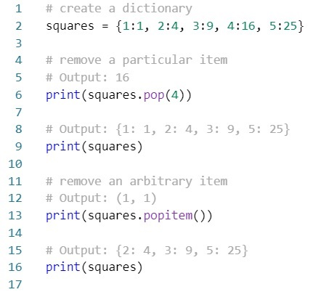
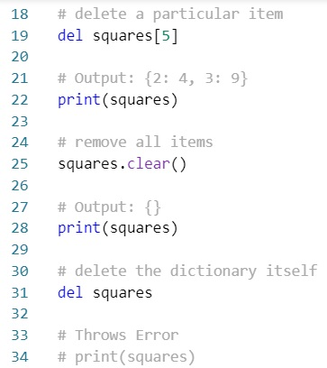
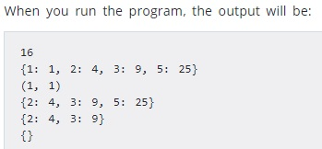
Code:

Slide 10
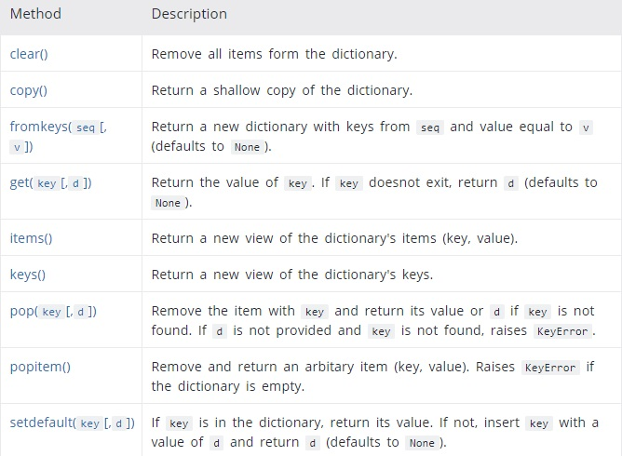

Dictionary methods:

Slide 11
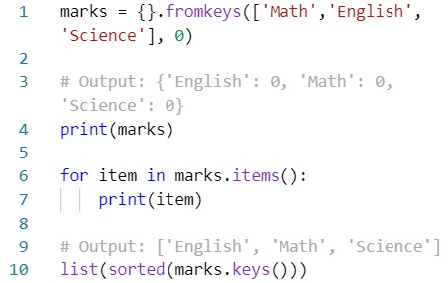
Example:

Slide 12

Dictionary comprehension:
Dictionary comprehension is an elegant and concise way to create new dictionary from an iterable in Python.
Dictionary comprehension consists of an expression pair ( key : value) followed by for statement inside curly braces { }.
Example:

Slide 13
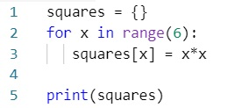
Workout:

Slide 14
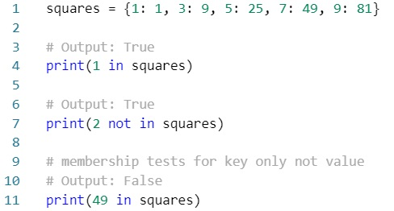
Dictionary membership test:
We can test if a key is in a dictionary or not using the keyword in.
Notice that membership test is for keys only, not for values.

Slide 15


Iterating through a dictionary:
Using a for loop we can iterate through each key in a dictionary.
Output

Slide 16
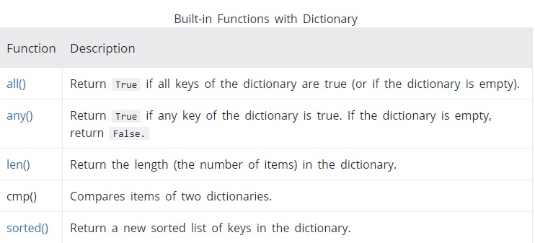
Built-in functions:

Slide 17
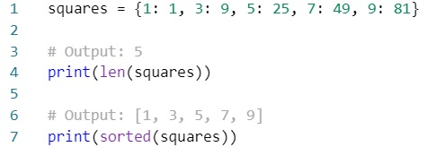
Example:
**End**

